Slide 1
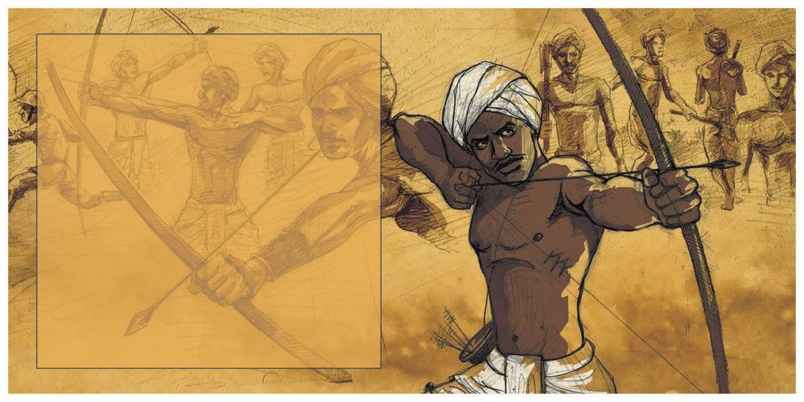
CLASS VIII HISTORY CHAPTER 4
TRIBALS,DIKUS AND THE VISION OF A GOLDEN AGE
MODULE 2/2

Slide 2
FOREST LAWS AND THEIR IMPACT
The British brought about several changes in the forest laws which severely affected the lives of many tribes. The British, for example, extended their control over all forests and declared that forests were state (government) property.
The British wanted timber, so the forests that produced it were classified as reserved forests where people were not allowed to move freely and practise jhum cultivation. As a result, several jhum cultivators moved away to other areas and lifestyles.

Slide 3
Colonial officials decided to give jhum cultivators small patches of land in the forests to cultivate, on the condition that they would have to provide labour to the Forest Department.
Naturally, many tribal groups revolted against the alien and unfair colonial forest laws.
EXAMPLE:
SONGRAM SANGMA IN 1906 IN ASSAM.
FOREST SATYAGRAHA IN 1930’S IN CENTRAL PROVINCES.

Slide 4
THE PROBLEM WITH TRADE
During the 19th century, traders and moneylenders began to come into the forests. They offered cash loans to the tribal people and asked them to work for wages.
In the 18th century, Indian silk was in demand in European markets, and the East India Company officials tried to encourage silk production in India to meet their growing demands.

Slide 5
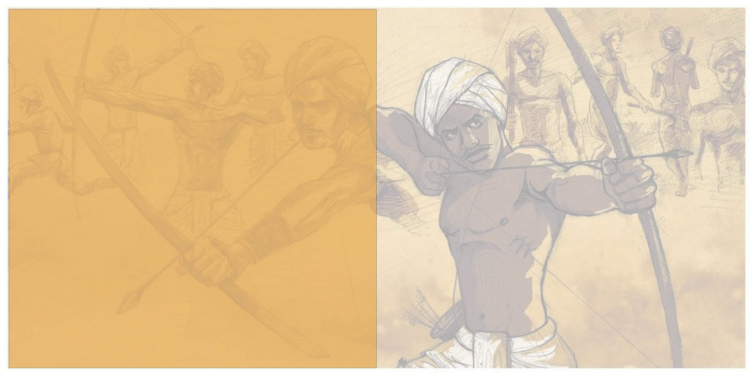
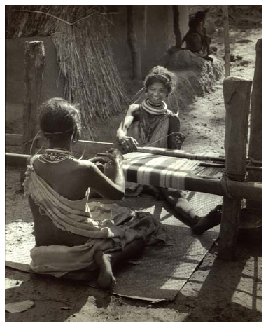
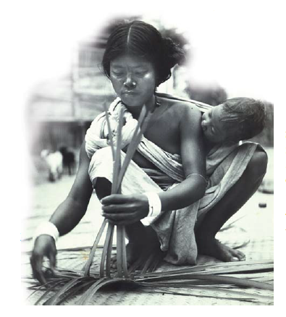
Godara women weaving
A Hajang woman weaving a mat

Slide 6
THE CASE OF THE SILK GROWERS
SANTHALS OF HAZARIBAGH
The Santhals of Hazaribagh reared silk cocoons, and silk traders sent in their agents who gave loans to them to collect the cocoons. The growers were paid 3 to 4 rupees for a thousand cocoons, which were then exported to Burdwarn or Gaya and sold at five times the price.
The middlemen -who arranged deals between the exporters and silk growers made huge profits.
This made the British traders richer and the Indian tribes poorer.
Many tribals saw market and the traders as their enemies.

Slide 7
THE SEARCH FOR WORK
The plight of the tribals who had to go far away from their homes for work was even worse; they were often recruited in large numbers to work the tea plantations of Assam and the coal mines of Jharkhand.
To the tribals, those new homes and jobs were not just unfamiliar but actually very unpleasant and dangerous, and they gradually lost their culture and tradition, their health, self-respect, and their familiar ways of life in the forest.

Slide 8
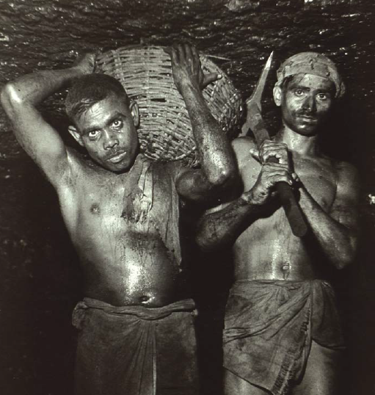
Coal miners of Bihar, 1948 In the 1920s about 50 percent of the miners in the
Jharia and Raniganj coal mines of Bihar were tribals. Work deep down in the dark and suffocating mines was not only backbreaking and dangerous, it
was often literally killing. In the 1920s over 2,000 workers died every year in
the coal mines in India.

Slide 9
A CLOSER LOOK
Through the 19th and 20th centuries ,tribal groups in different parts of the country rebelled against the changes in laws ,the restrictions on their practices, and the exploitation by traders, moneylenders and the Britishers. Some of the popular revolts are as follows:
THE KOLS 1831-32
THE SANTHALS 1855
THE BASTAR REBELLION 1910
THE WARLI REVOLT 1940
THE MUNDAS 1890’S

Slide 10
A CLOSER LOOK
BIRSA MUNDA
Birsa Munda declared that God had appointed him to save his people from trouble, to free them from the slavery of dikus (foreigners, robbers).
Thousands became the followers of Birsa.
A movement began under the leadership of Birsa; the political aims of the Birsa Movement were to drive out Christian missionaries, moneylenders, Hindu landlords, and the government, and to set up a Munda Raj.

Slide 11
As the movement spread, British government officials arrested Birsa in 1895, and in 1897, he was released.
He then toured the villages to gather support for his movement. He urged people to destroy the Ravanas (European devils) and establish an independent kingdom under his leadership.
Birsa died in 1900 and the movement initiated by him faded out, but historians even today study it as an important and popular event in the story of British-ruled India.

Slide 12
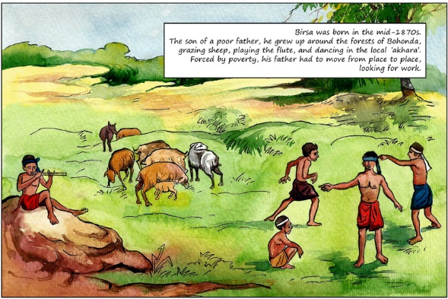

Slide 13
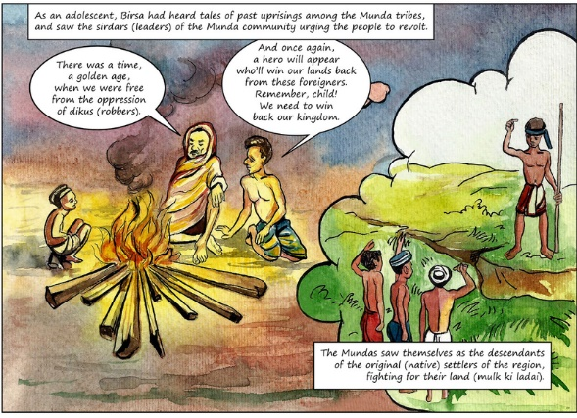

Slide 14
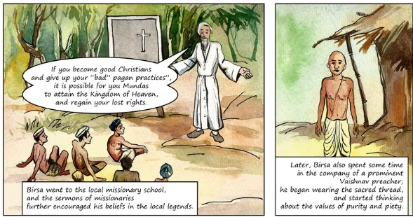

Slide 15
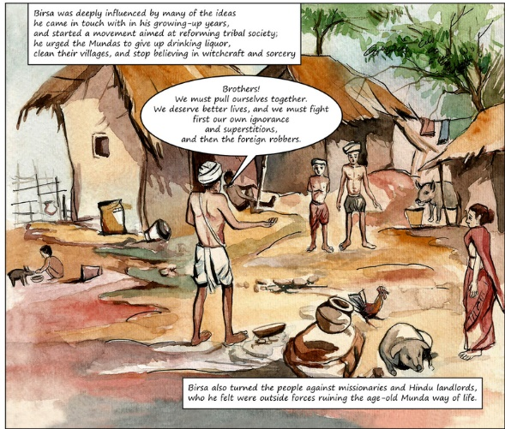
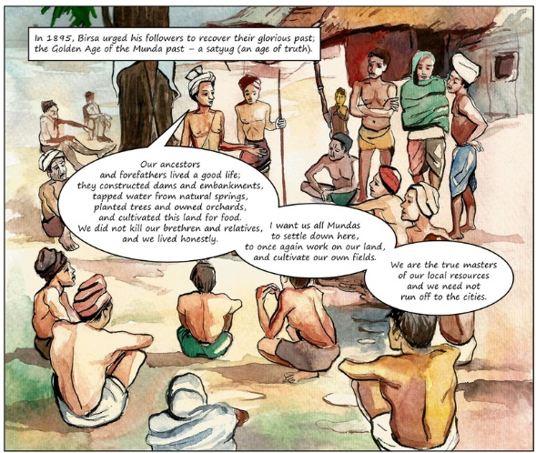

Slide 16
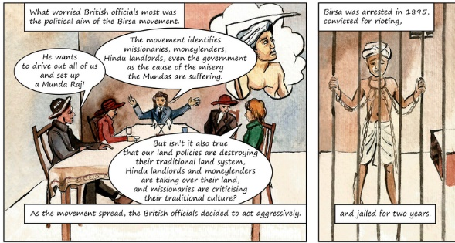

Slide 17
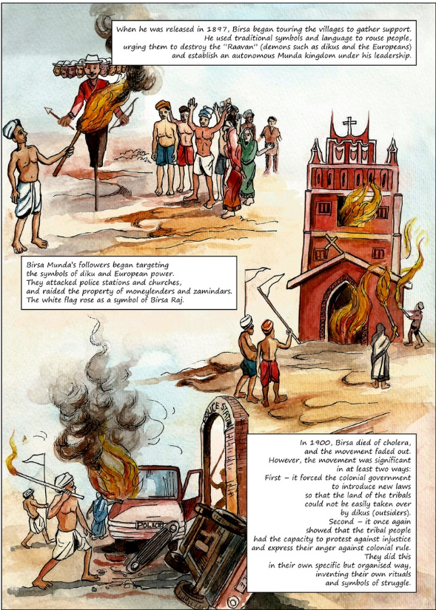
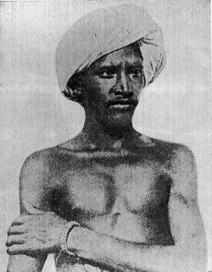
BIRSA MUNDA

Slide 18
LET US RECALL
FOREST LAWS AND THEIR IMPACT
THE PROBLEM WITH TRADE
THE PLIGHT OF SILK GROWERS
POPULAR TRIBAL REVOLTS
BIRSA MUNDAS PARTICIPATION MUNDA REVOLT

Slide 19
LET US DISCUSS
WHAT WAS THE MAIN ACTIVITY OF SANTHALS OF HAZARIBAGH?
WHO WERE CONSIDRED AS ENEMIES FOR THE TRIBALS?
NAME ANY TWO TRIBAL REVOLTS WHICH HAPPENED IN THE 19TH CENTURY.
WHAT WAS THE AIM OF BIRSA?

